Slide 1

Video Tour

Slide 2
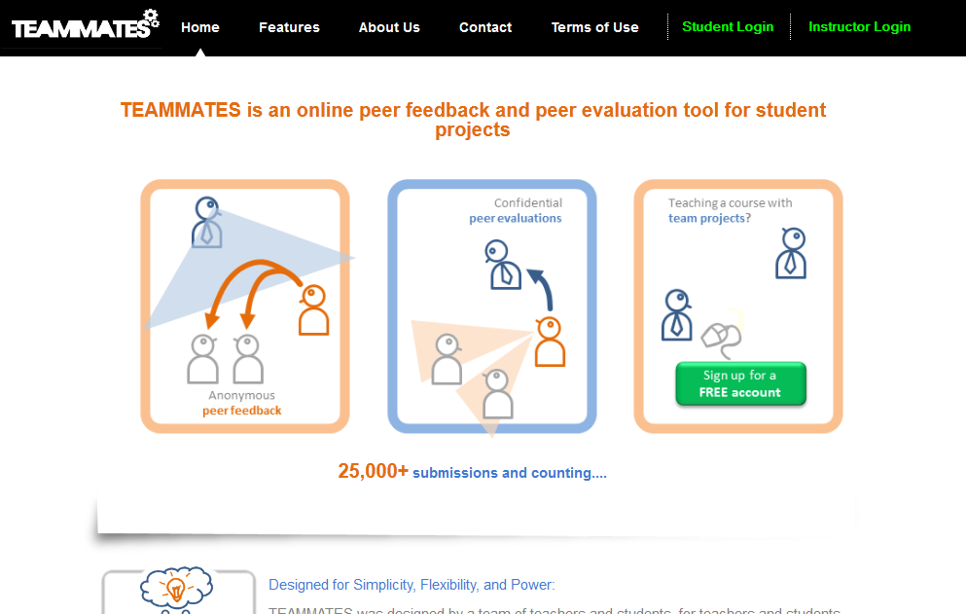
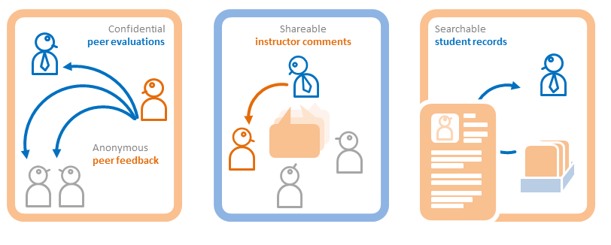
Student peer evaluations/feedback, shareable instructor comments, and more...
Video Tour

Slide 3
Home
Video Tour

Slide 4
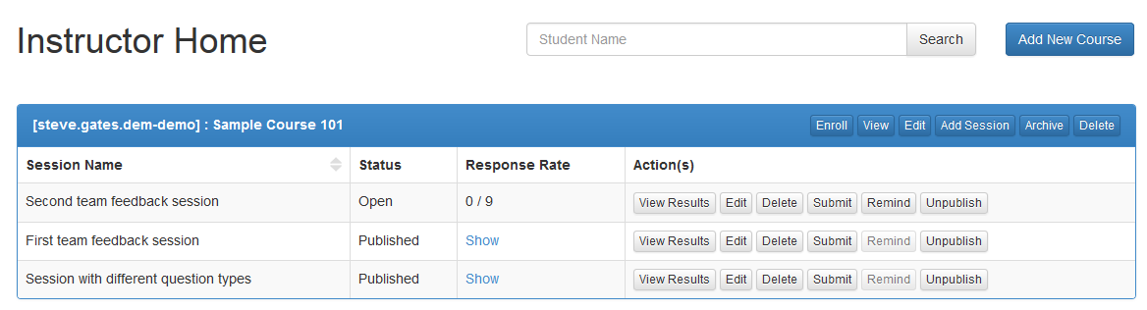
Home
Sample data that come with new accounts

Slide 5
Home
Create a new course

Slide 6
Courses

Slide 7
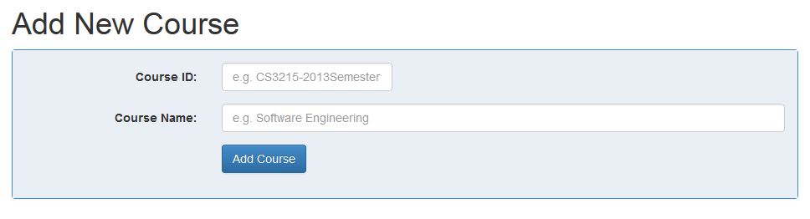
Courses
Hover over items to see helpful tips
Enter a unique ID for the course. E.g., CS101-2013-Sem1

Slide 8
Courses
Fill in the course details
ECON101-2013Fall
Introduction to Economics

Slide 9
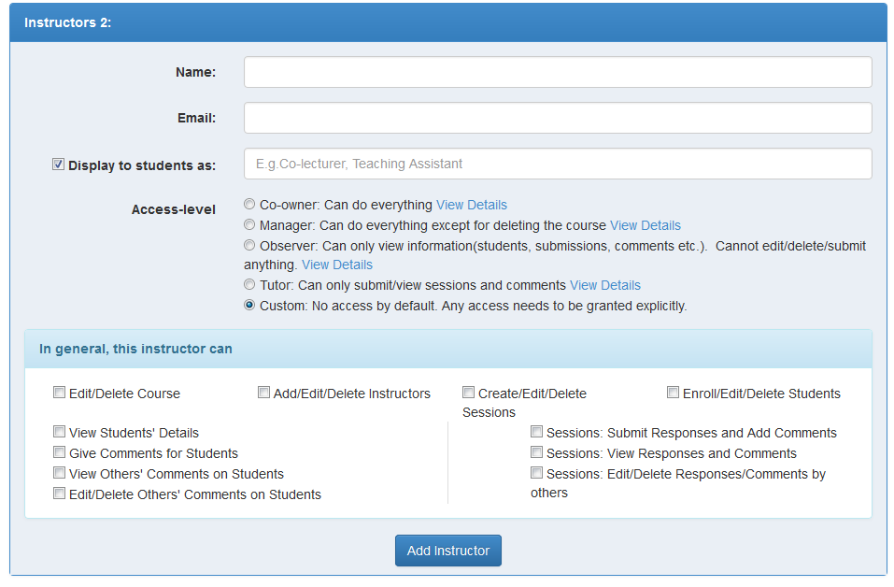
Courses
You can add more instructors, with desired permission levels

Slide 10
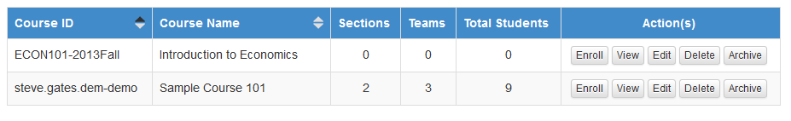
Courses
Enroll students in the new course

Slide 11
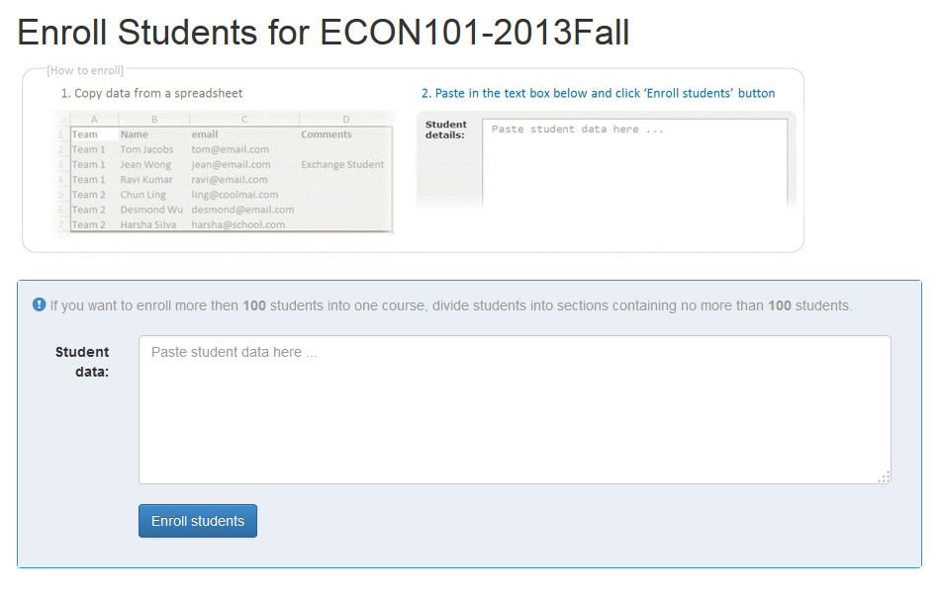
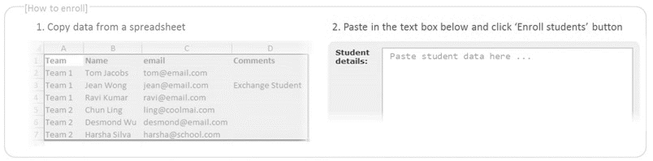
Courses
Instructions are here

Slide 12
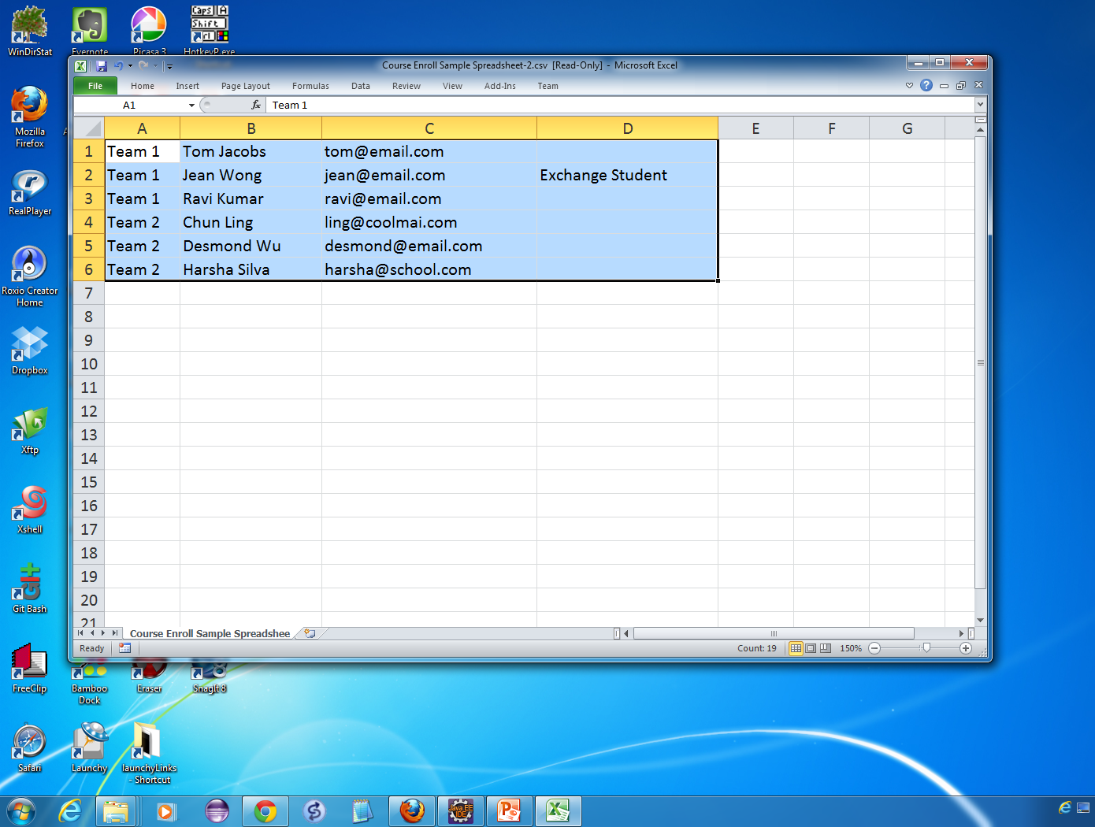
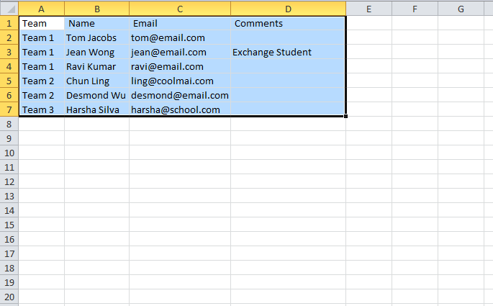
Copy student data

Slide 13
Courses
Paste here
Team Name email Comments
Team 1 Tom Jacobs tom@email.com
Team 1 Jean Wong jean@email.com Exchange Student
Team 1 Ravi Kumar ravi@email.com
Team 2 Chun Ling ling@coolmail.com
Team 2 Desmond Wu desmond@email.com
Team 2 Harsha Silva harsha@school.com

Slide 14
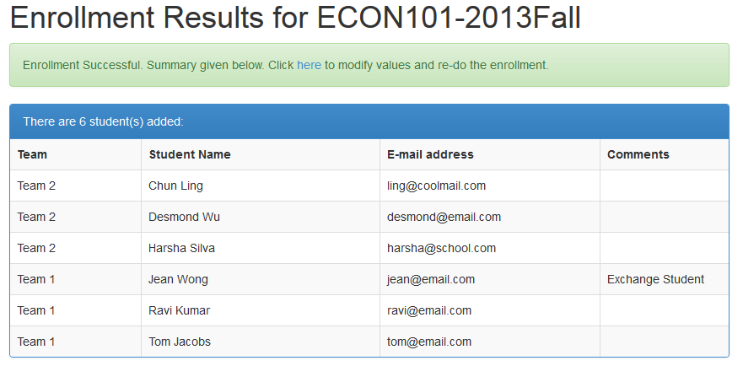
Courses
Next, create a new session
Students enrolled

Slide 15
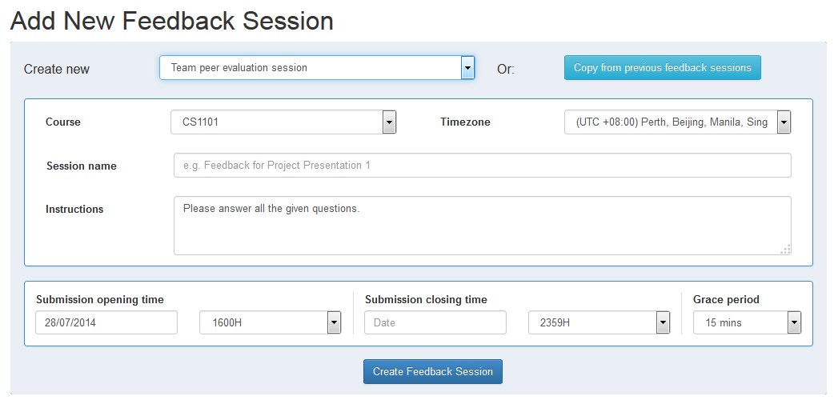
Sessions
Choose from given templates
Or copy an existing session

Slide 16
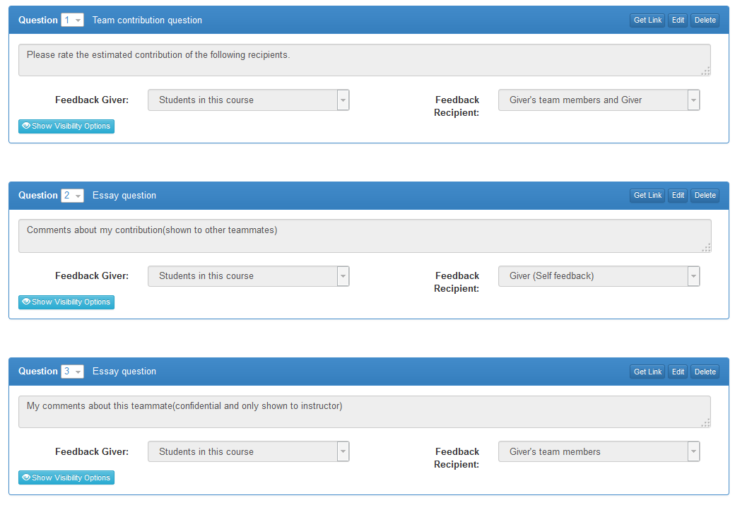
Sessions
You can edit questions

Slide 17
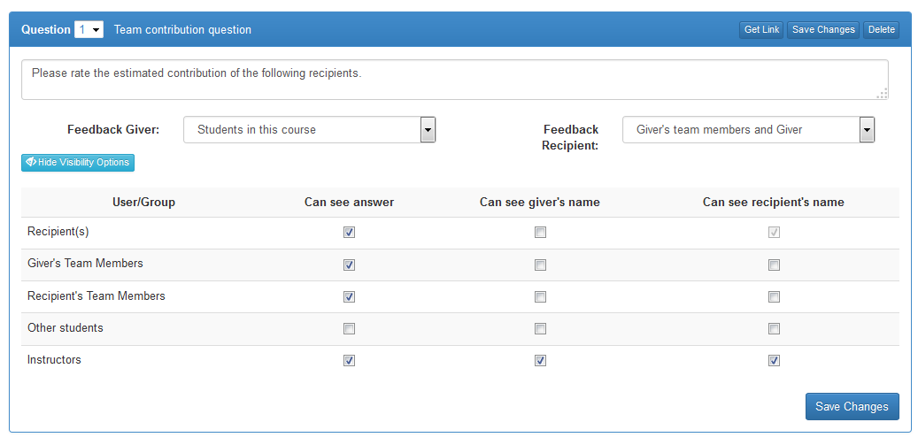
Sessions
You can edit questions

Slide 18



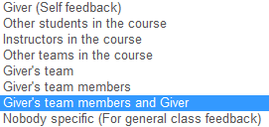
Sessions
You can edit questions
Many feedback paths available

Slide 19
Sessions
You can edit questions

Slide 20


Sessions
You can edit questions
Visibility levels can be set for each question

Slide 21
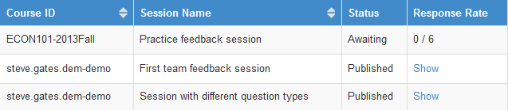
Sessions
At the session opening time …

Slide 22
Student View →

Slide 23
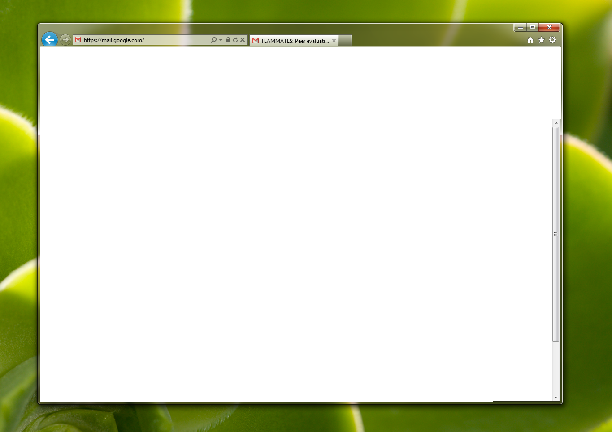
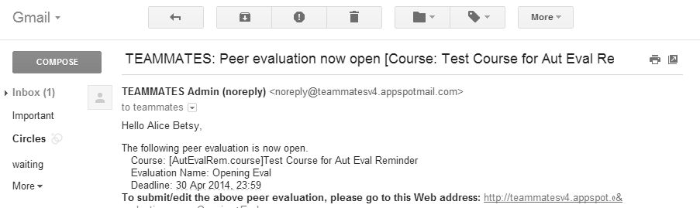
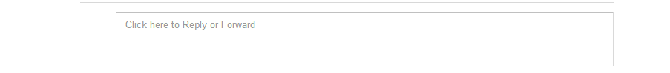
TEAMMATES: [ECON101-2013Fall] Introduction to Economics
Hello Tom Jacobs,
The following peer evaluation is now open. Course: [ECON101-2013Fall]Introduction to Economics Evaluation Name: Group project peer evaluation Deadline: 30 Apr 2014, 23:59
To join the course and submit evaluations, click here
Regards, TEAMMATES Team.
… students receive email alerts.

Slide 25

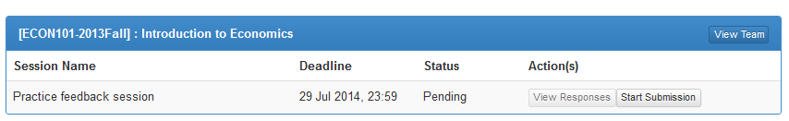
Home

Slide 26
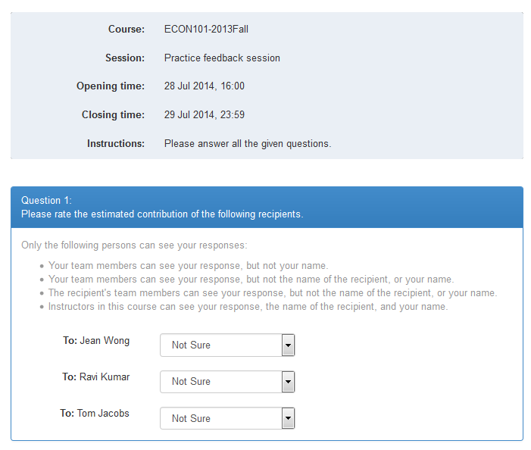
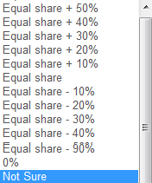
Students estimate own/peer contributions

Slide 27
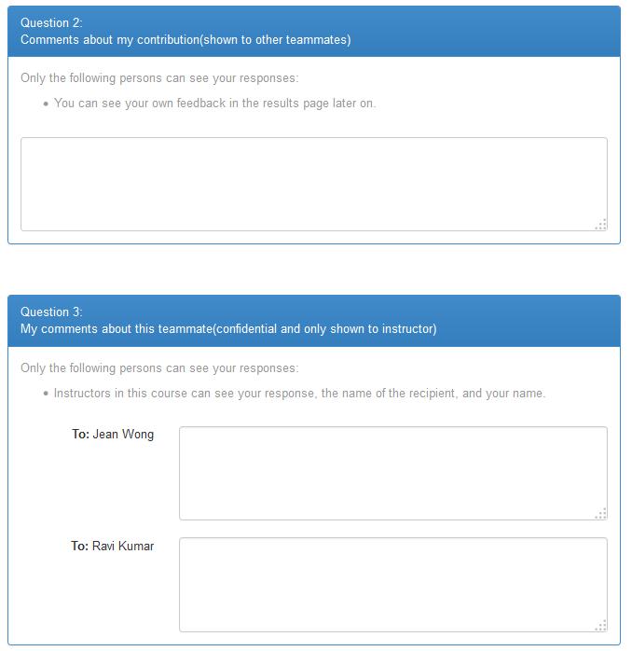
Comments about own contribution
Confidential comments about peers

Slide 28
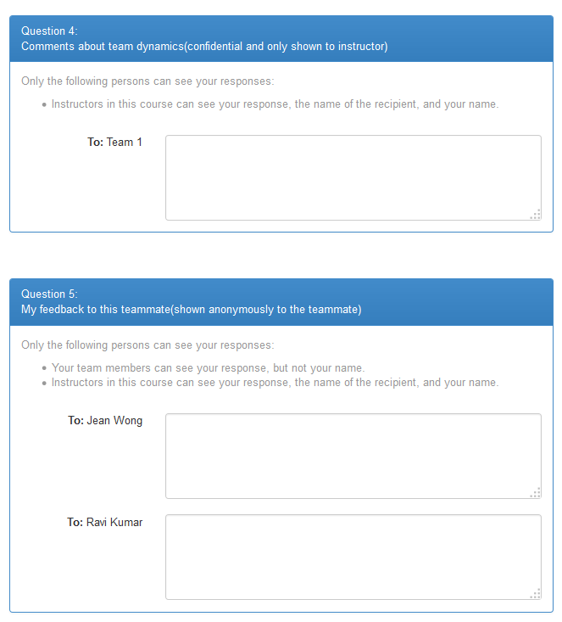
Comments about team dynamics
Anonymous feedback to peers

Slide 29
← Instructor View

Slide 30
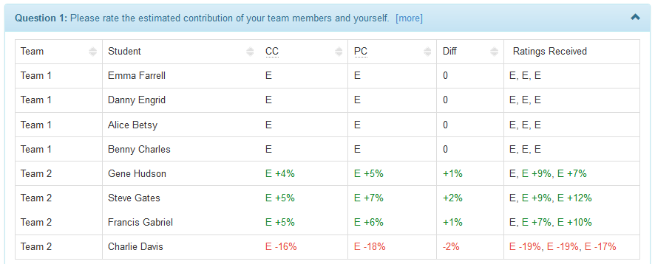
Sessions
Instructors can view session results.
See contribution levels at a glance…

Slide 31
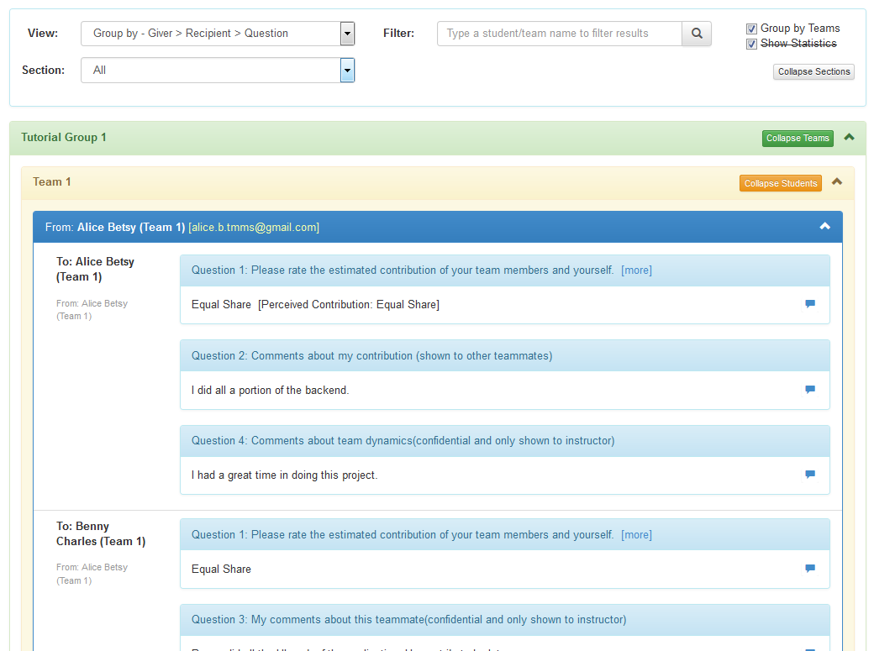
Sessions
View more detailed reports…

Slide 32


Sessions
View more detailed reports…
View responses in different formats

Slide 33
Sessions
View more detailed reports…

Slide 34


Sessions
And drill down to details.
View more detailed reports…

Slide 35
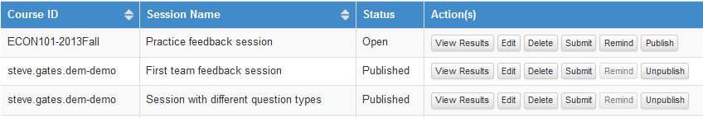
Sessions
Publish to students

Slide 36
Student View →

Slide 37
TEAMMATES: [ECON101-2013Fall] Group project peer evaluation
Hello Emily Fowler,
The following peer evaluation results are now published. Course: [ECON101-2013Fall]Introduction to Economics Evaluation Name: Group project peer evaluation Deadline: 30 Apr 2014, 23:59
To view results, click here
Regards, TEAMMATES Team.
… students receive link to results.

Slide 38

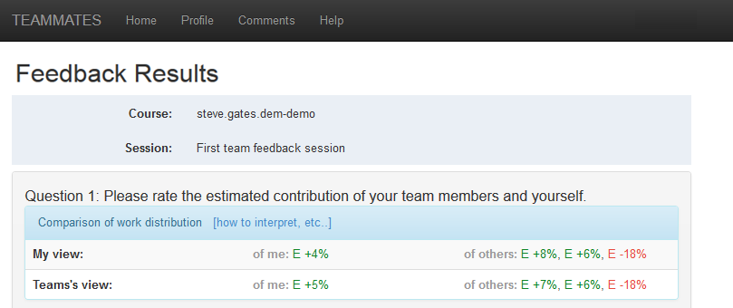
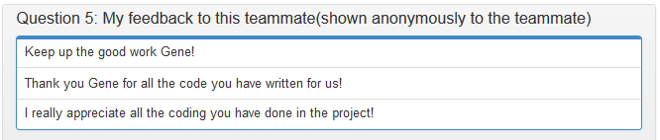
Can compare own perception to team perception
Anonymous peer feedback

Slide 39
← Instructor View

Slide 40
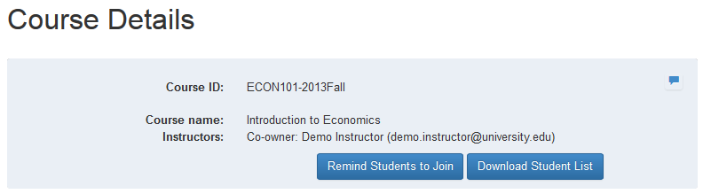
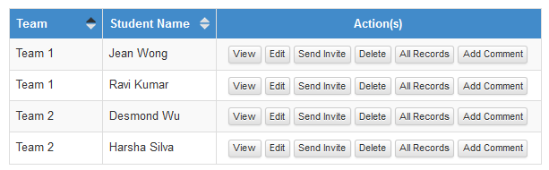

Courses
Add comments to students/teams

Slide 41
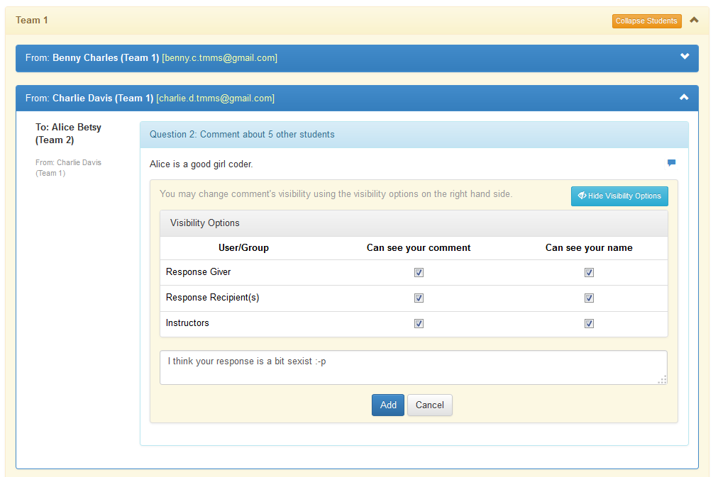
Sessions
Add comments to responses submitted.
Make comments visible to others.

Slide 42
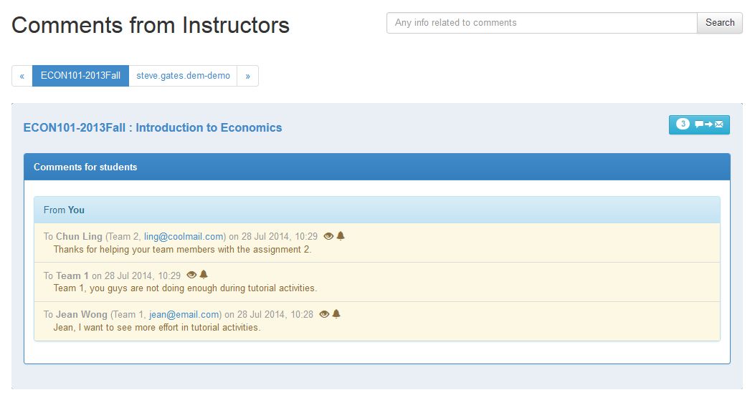
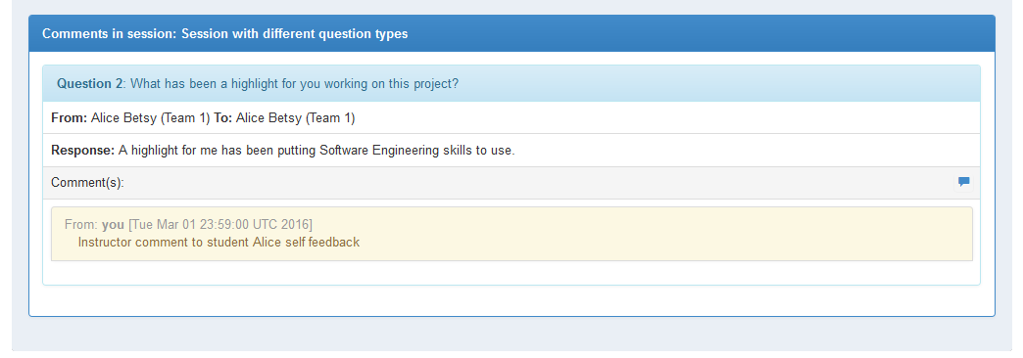
Comments
Manage all comments in this page
Email students about comments

Slide 43
Students
Include filter capability

Slide 44
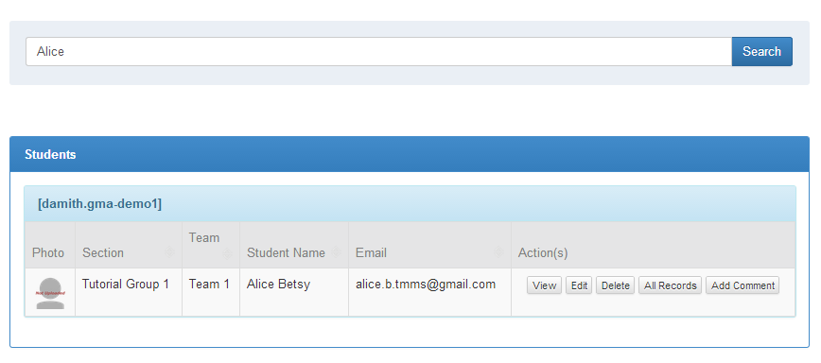

Students
Locate students using search
View all details of a student
Photo: Brad Flickinger @ Flickr

Slide 45
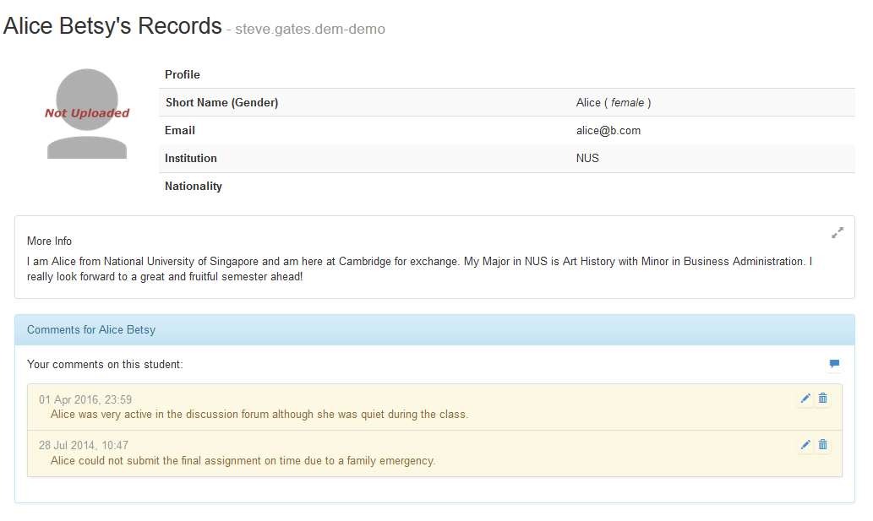

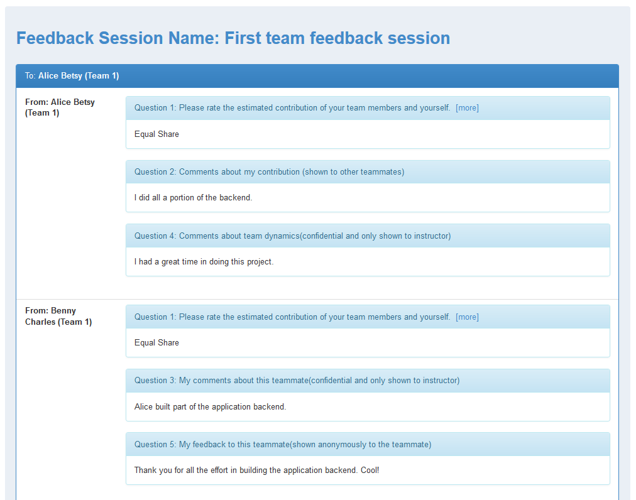
Students
All comments/responses from/to the student are shown here.
Photo: Brad Flickinger @ Flickr

Slide 46
See here for more details.
Student peer evaluations/feedback, shareable instructor comments, and more...
http://TeammatesOnline.info

Slide 47
